Slide 1
Using Saturn Cloud PyTorch TabNet with Dask
Nathan Ballou
09/09/2021

Slide 2
Motivation
Interact with and learn more about the Saturn Cloud interface.
Learn more about Dask.
Try a recently used technique on an old problem.

Slide 3
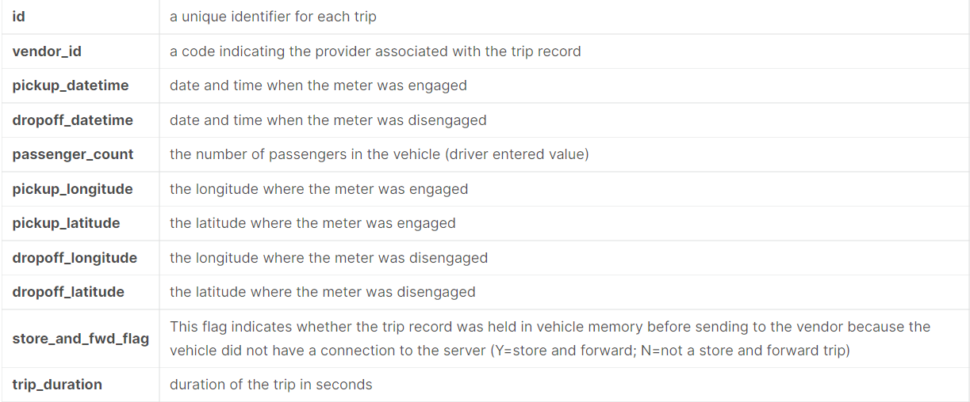
Problem: Kaggle NYC Taxi Trip Duration
Train: 1,458,644 trip records
Test: 625,134 trip records
Objective: Predict the trip duration.

Slide 4
Approach
Preprocess as required (e.g., remove outliers, feature engineering).
Run a PyTorch TabNet model on the dataset.
Complete a 5-fold cross validation with 3 seeds.
Run each fold/seed combination as a separate Dask task.
Run all computations with GPU accelerators.

Slide 5
Results
Ran model on a three-worker Dask cluster.
The model took approximately two hours of compute to complete the cross validation and seeds.
It did not work very well:
RMSLE for TabNet: 0.44
RMSLE for LightGBM (without cv or seeds) : 0.38

Slide 6
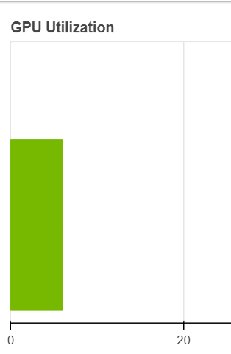
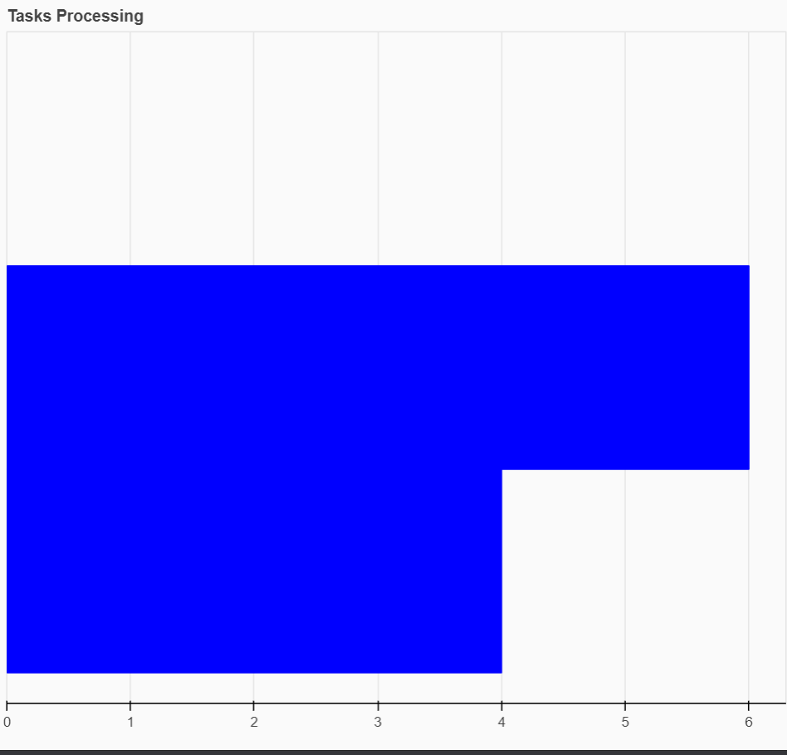
Issues
< 20% GPU utilization
One worker finished significantly before others.
Also, the RMSLE

Slide 7
Takeaways
Sometimes simpler models work better.
Sometimes more compute does not lead to better or more accurate results.
Working in Saturn Cloud and with Dask was new and informing, so nonetheless worthwhile.

Slide 8
How I Would Teach This Problem
I would not ☺
Why not?
The results were below benchmarks.
A pipeline would be a better approach.
The compute time was too long for a reasonable tutorial.
What I would do: simplify the problem to focus on understanding Dask concepts and on interpreting dashboards.

Slide 9
What I Like About Saturn Cloud
Overall interface
Ease of starting servers and clusters
Integration with Jupyter Lab
Dashboards for workers and processes

Slide 10
How Saturn Cloud Could Be Improved
Improve documentation, which currently:
Seems slightly fragmented
Lacks information about Git integration
Lacks information about interpreting dashboards
Decrease the start time for servers (particularly the image step).
Extend functionality to create other cluster types (e.g., Ray).
Improve dashboard aesthetics/UI.

Slide 11
Questions?
Thank you for the opportunity!

